Slide 1
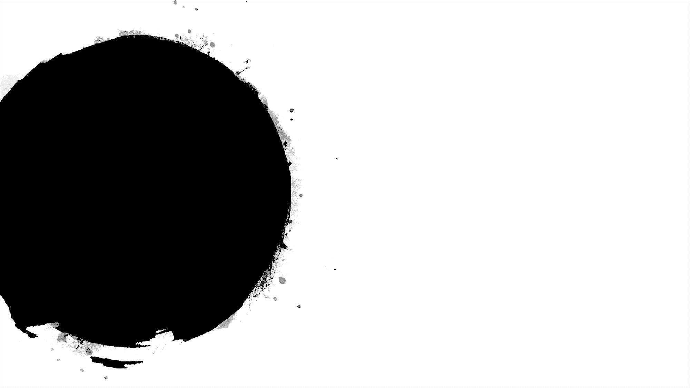

Cricket
Score
Prediction
Presented By:
SK.Gouse Mastan Vali-17471A0502
D.Vamsi Krishna-17471A0552
K.S.L.Narayana-17471A0542
A.Sairam-17471A0555
Under the guidance of:
P.Lakshmi Narayana M.Tech
Asst professor

Slide 2
Abstract
Winning is the goal of any sport. Cricket is one the most watched sport now a days. Winning in Cricket depends on various factors like home crowd advantage, performances in the past, experience in the match, performance at the specific venue, performance against the specific team and the current form of the team and the player.
Here we predicts the score of first innings not only based on current run rate but also considers number of wickets fallen, venue ,batting team, batsman, bowler, etc..
to predict the cricket score I have taken the dataset from espn.cricksheet
In this Project, a model has been proposed that predicts the score in each of the innings using Linear Regression , Random Forest algorithm, Lasso, Support Vector Regression, Kneigbhor, Decision Tree.

Slide 3
Introduction
Cricket is being played in many countries all around the world. There are a lot of domestic and international tournaments being held in many countries which play cricket.
Cricket is a game played between two teams comprising of 11 players in each team. The result is either a win, loss or a tie(same score/weather).
Moreover, this game is also extremely unpredictable because at every stage of the game the momentum shifts to one of the teams between the two.
A lot of times the result gets decided on the last ball of the match where the game gets really close.
Considering all these unpredictable scenarios of this unpredictable game, there is a huge interest among the spectators to do some prediction either at the start of the game or during the game.
So, keeping in mind all these possibilities, this report aims at studying the problem of predicting the game results before the game has started based on the statistics and data available from the data set.

Slide 4
odi.csv -> 1188 matches (Ball to ball coverage)
Dataset consist of following columns(features):
mid -> Each match is given a unique number
date -> When the match happened
venue -> Stadium where match is being played
bat_team -> Batting team name
bowl_team -> Bowling team name
batsman -> Batsman name who faced that ball
bowler -> Bowler who bowled that ball
runs -> Total runs scored by team at that instance
wickets -> Total wickets fallen at that instance
overs -> Total overs bowled at that instance
runs_last_5 -> Total runs scored in last 5 overs
wickets_last_5 -> Total wickets that fell in last 5 overs
striker -> max(runs scored by striker, runs scored by non-striker)
non-striker -> min(runs scored by striker, runs scored by non-striker)
total -> Total runs scored by batting team after first innings
Dataset

Slide 5
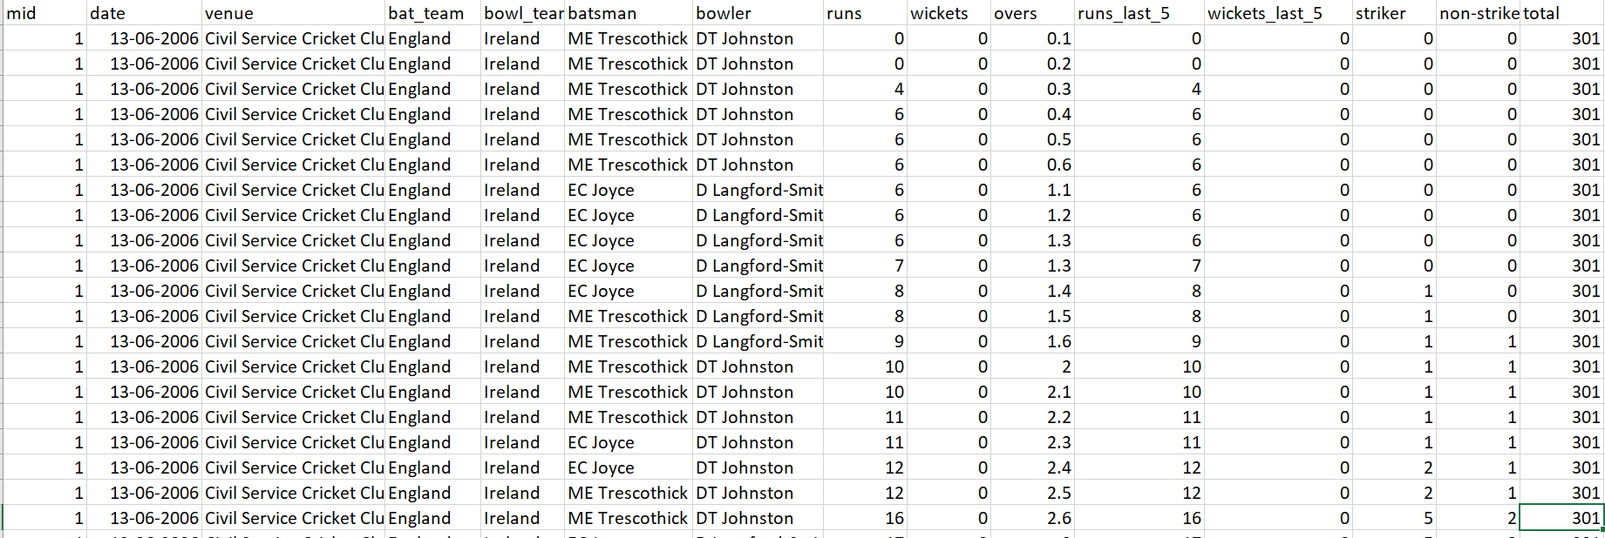
Dataset

Slide 6
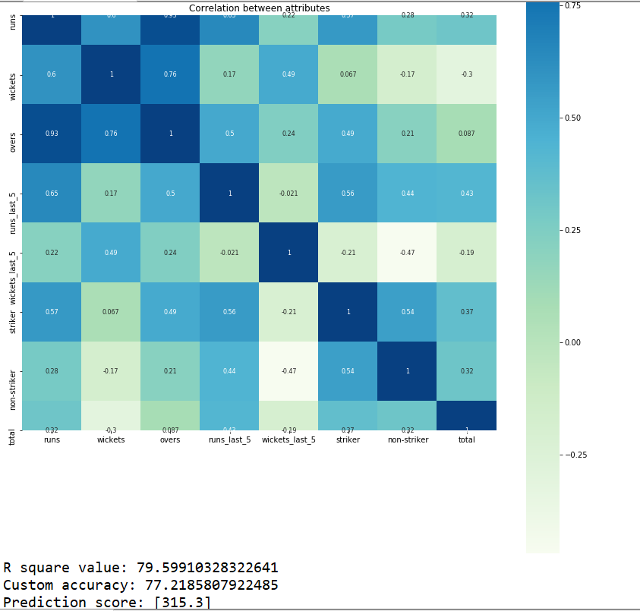
Heat map (Before)

Slide 7
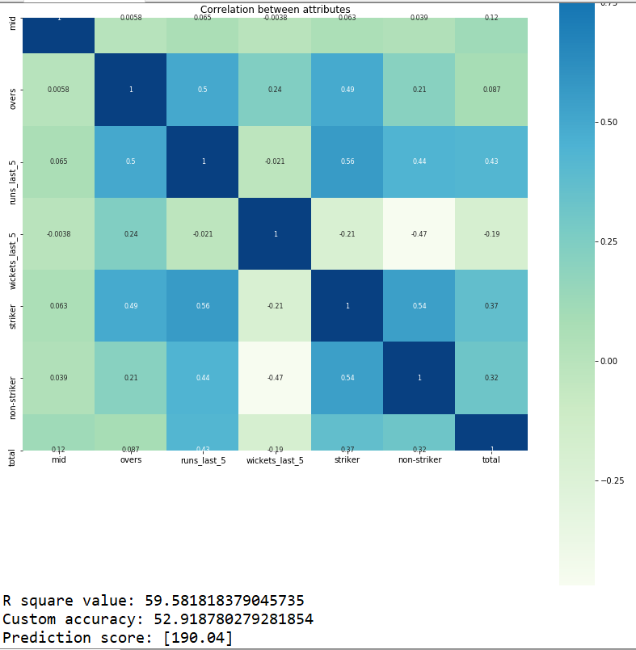
Heat Map (After)

Slide 8
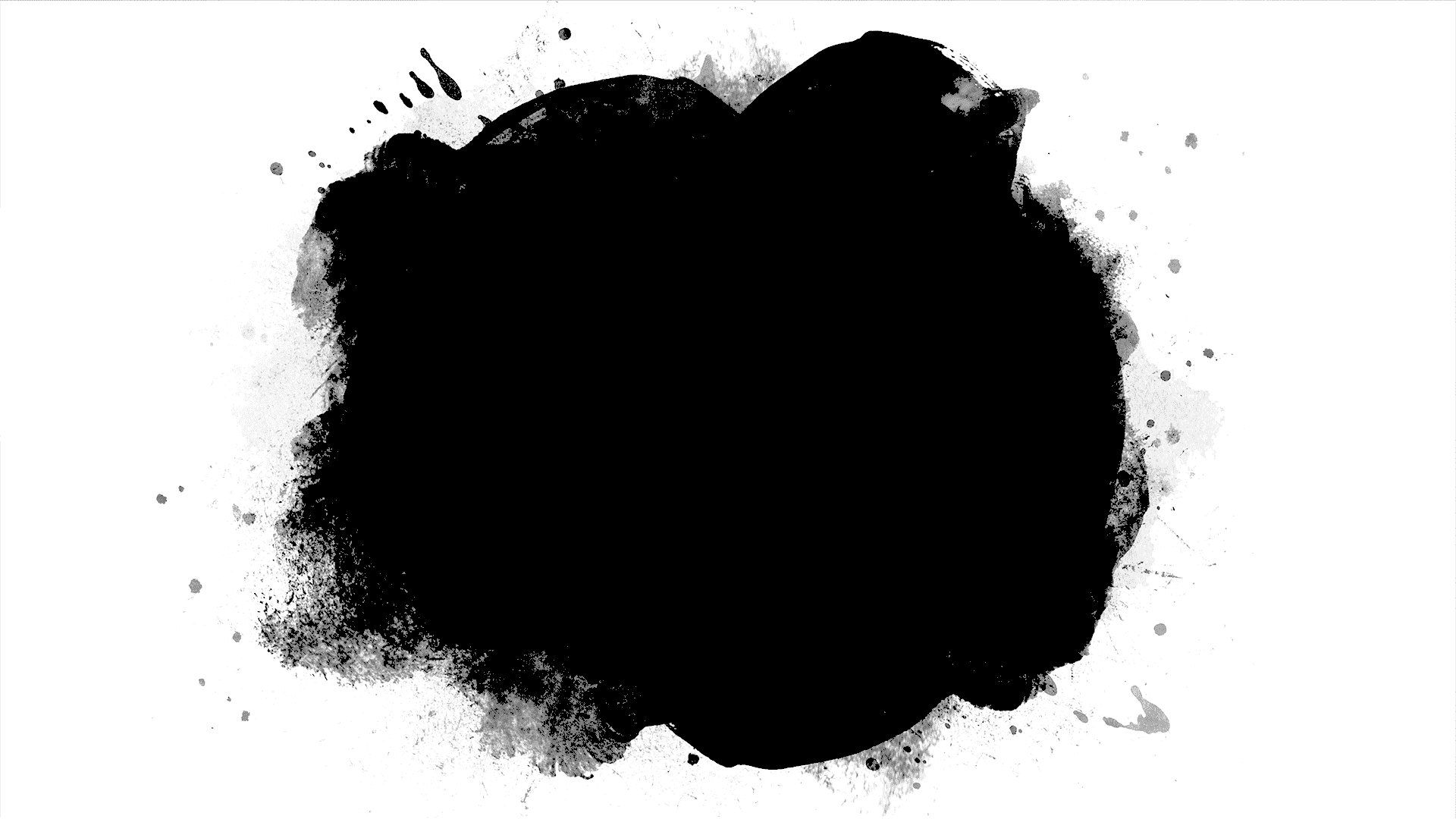
Algorithms

Slide 9
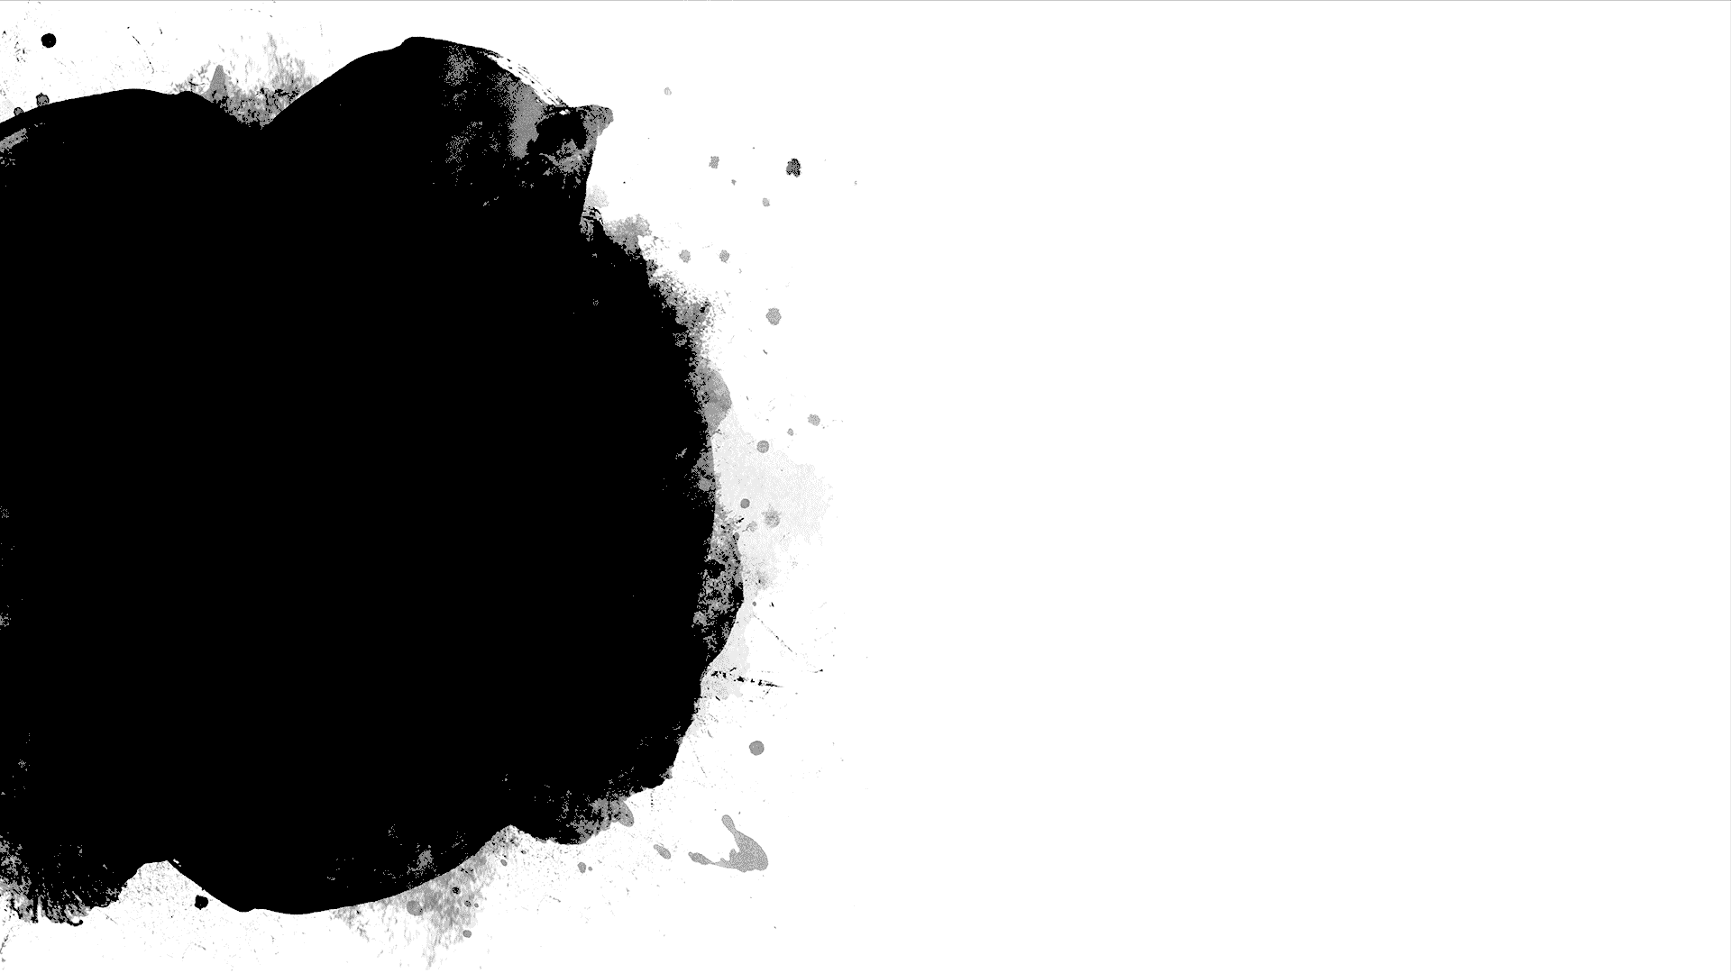
Random Forest is a Supervised Learning algorithm which uses for classification(Fixed) and regression(Continuous data).
It can handle missing values, and also can be modeled for continuous values
It creates decision tree on data samples and then get the prediction from each of them and get the best solution
Random Forest

Slide 10
Linear Regression
Linear regression is a way to explain the relationship between a dependent variable and one or more explanatory variables using a straight line.
Once we use linear regression on a data-set divided into training and test set, calculating the scores on training and test set can give us a idea about whether the model is suffering from over-fitting or under-fitting or none
Linear regression can be used to fit a predictive model to a set of observed values (data).
This is useful, if the goal is prediction, or forecasting, or reduction

Slide 11
Ridge and Lasso
These are special linear regressions
Ridge and Lasso regression are some of the simple techniques to reduce model complexity and prevent over-fitting which may result from simple linear regression
large number of features and test score is relatively poor than the training score over fitting

Slide 12
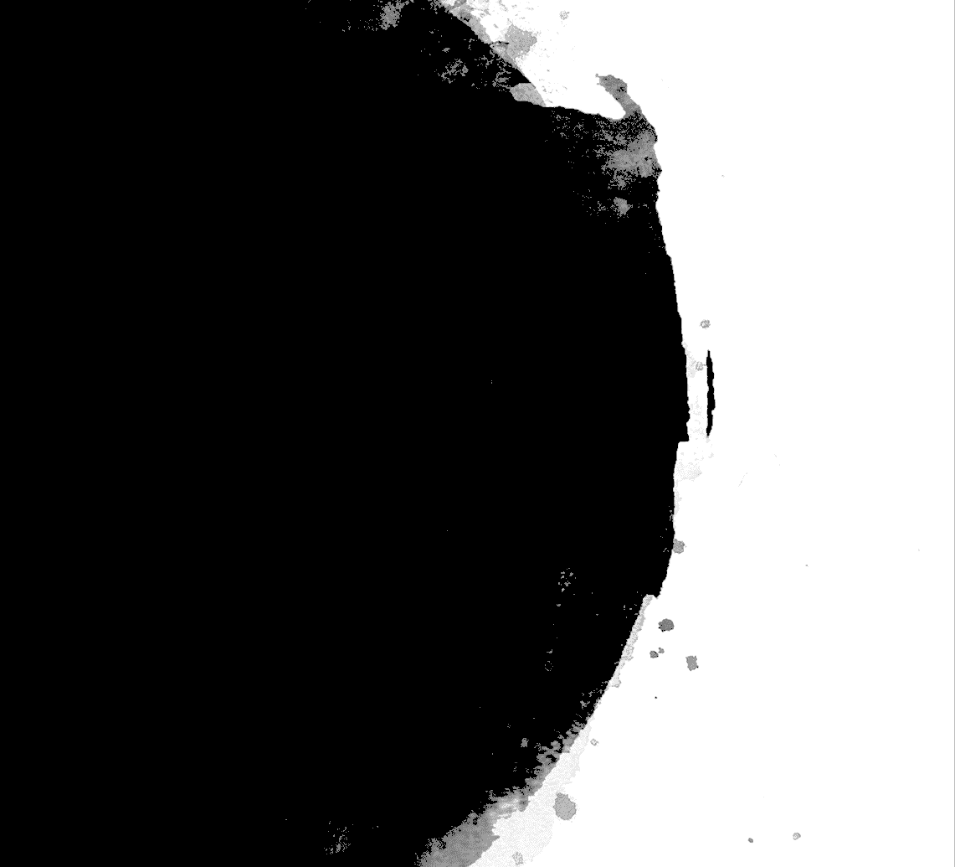
Ridge regression shrinks the coefficients and it helps to reduce the model complexity and multi-collinearity
LASSO stands for Least Absolute Shrinkage and Selection Operator.
Lasso regression not only helps in reducing over-fitting but it can help us in feature selection.

Slide 13
Support Vector Regression(SVR) is quite different than other Regression models.
It uses the Support Vector Machine algorithm to predict a continuous variable.
While other linear regression models try to minimize the error between the predicted and the actual value, SVR tries to fit the best line within a predefined or threshold error value.
What SVR does in this sense, it tries to classify all the prediction lines in two types, ones that pass through the error boundary( space separated by two parallel lines) and ones that don’t.
Those lines which do not pass the error boundary are not considered as the difference between the predicted value and the actual value has exceeded the error threshold, 𝞮(epsilon). The lines that pass, are considered for a potential support vector to predict the value of an unknown
Support Vector Regression

Slide 14
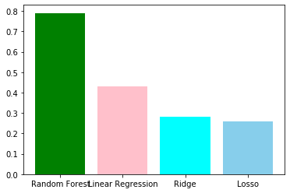
Comparison of algorithms without Correlation

Slide 15
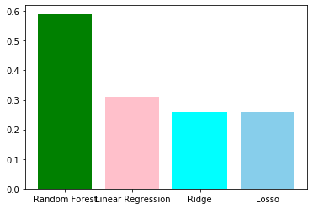
Comparison of algorithms with correlation

Slide 16
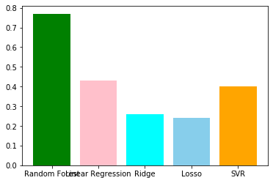
Comparison of algorithms with PCA

Slide 17
Conclusion
In this project, we implemented Random Forest regression for finding out the cricket score and data from espn website
The main motive of this project is to show how to predict the cricket score with such giant dataset which has missing values as well as regularities.

Slide 18
Future Scope
In future, the application can be enhanced by implementing decision tree regressor algorithm ,k nearest neighbor regression, elcat algorithm in which we can find the correlation between every independent variable.
Developing Android app or IOS app or Web application to provide users in an easy manner.

Slide 19

Thank you

